Slide 1
ISPAD 2022 Exercise Guidelines: From Recommendations to Heuristics Using Science to Create Art
John Pemberton RD
Birmingham Women’s and Children’s Foundation Trust

Slide 2
Disclosures
Advisory Board for ROCHE Diabetes
Speaker fees from Dexcom
Co-author of the ISPAD 2022 Exercise Guidelines

Slide 3
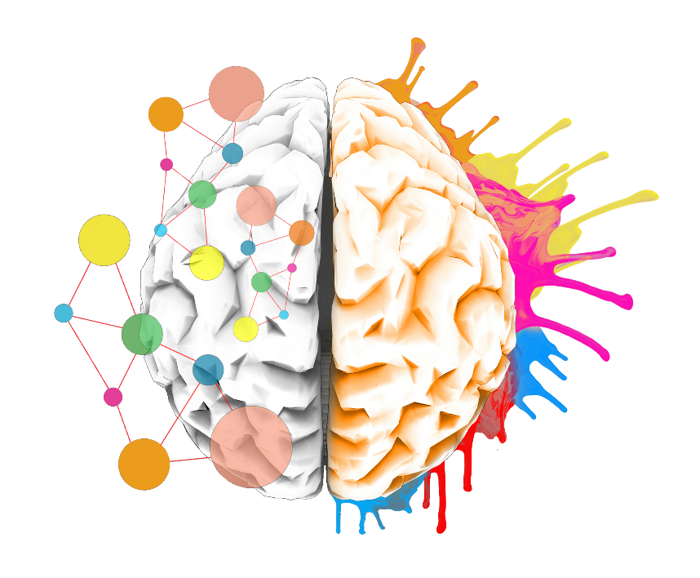
Agenda
Skin in the Game - Nassim Nicolas Taleb:
Those who give advice:
Should be exposed to risk
Should have deep local knowledge
Should practice what they preach
Good advice is art informed by science
Taleb, Nassim Nicholas. Incerto. Random House Publishing Group, 2021
ISPAD 2022: Using Science (Recommendations) to create Art (Heuristics)
10 by 2 (mmol/L) or 10 by 40 (mg/dL)
50/50/20 (MDI and insulin pumps)
25/25/Target (AID)
The Glucose Never Lies (if the glucose stays in range – IT WORKS!

Slide 4
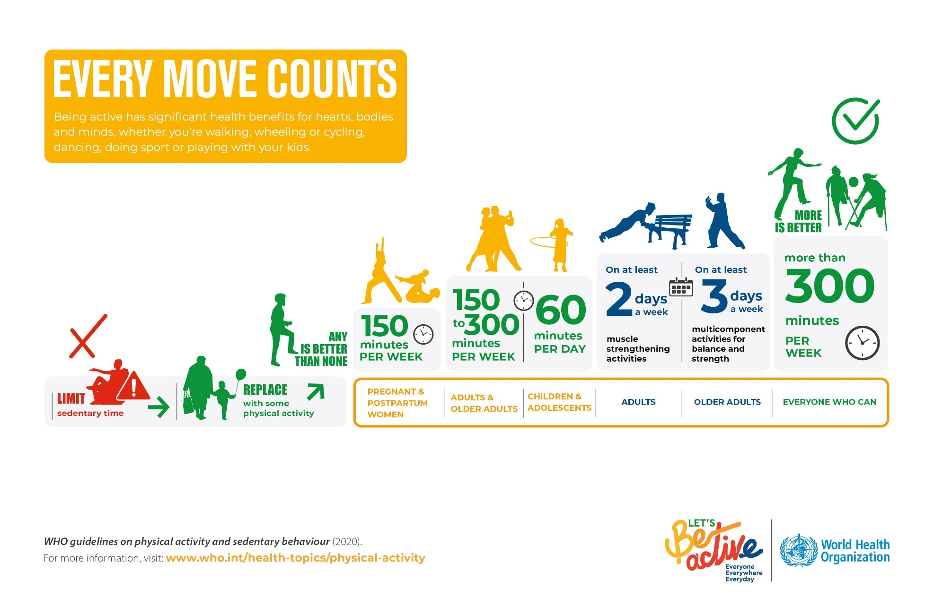
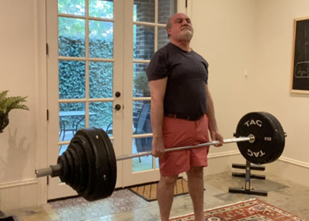
WHO recommendations
“Those who teach should do”
Nicolas Nassim Taleb
Skin in the Game

Slide 5
Meeting the WHO recommendations?
Less than 10% of children worldwide meet WHO movement targets
Tapia-Serrano et al., J Sport Health Sci. 2022;11(4):427-437.
Children with T1D have lower activity levels than their peers
De Lima et al., Pediatr Exerc Sci. 2017;1;29(2):213–9.
Czenczek-Lewandowski et al., Int J Environ Res Public Health. 2019;16(18):3498.
Fear of hypoglycaemia is a major barrier
Jabbour et al., Can J diabetes. 2019;40(2):170–2.

Slide 6
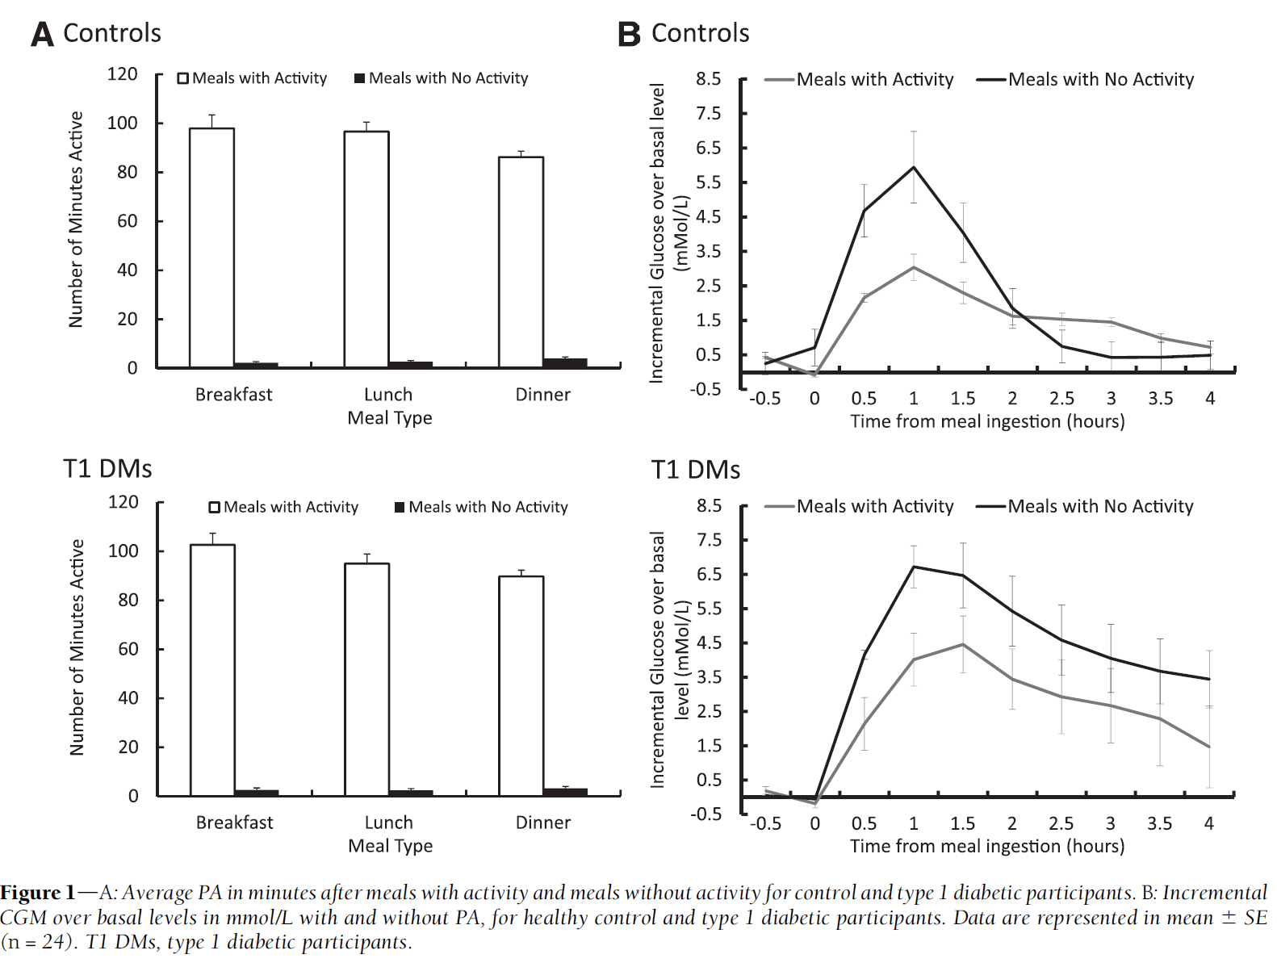
Walking at usual pace after eating
12 T1D adults and 12 controls
It’s an EVERYBODY thing,
Not just a T1D thing!
Manohar et al., Diabetes Care 2012;35:2493–2499
Notes:
OBJECTIVEdPhysical activity (PA), even at low intensity, promotes health and improves
hyperglycemia. However, the effect of low-intensity PA captured with accelerometery on glucose
variability in healthy individuals and patients with type 1 diabetes has not been examined.
Quantifying the effects of PA on glycemic variability would improve artificial endocrine pancreas
(AEP) algorithms.
RESEARCH DESIGN AND METHODSdWe studied 12 healthy control subjects (five
males, 37.7 6 13.7 years of age) and 12 patients with type 1 diabetes (five males, 37.4 6 14.2
years of age) for 88 h. Participants performed PA approximating a threefold increase over their
basalmetabolic rate. PAwas captured using a PA-monitoring system, and interstitial fluid glucose
concentrations were captured with continuous glucose monitors. In randomorder, one meal per
day was followed by inactivity, and the other meals were followed by walking. Glucose and PA
data for a total of 216 meals were analyzed from 30 min prior to meal ingestion to 270 min
postmeal.
RESULTSdIn healthy subjects, the incremental glucose area under the curve was 4.5mmol/L/
270min formeals followed by walking, whereas it was 9.6mmol/L/270 min (P = 0.022) for meals
followed by inactivity. The corresponding glucose excursions for those with type 1 diabetes were
7.5 mmol/L/270 min and 18.4 mmol/L/270 min, respectively (P , 0.001).
CONCLUSIONSdWalking significantly impacts postprandial glucose excursions in healthy
populations and in those with type 1 diabetes. AEP algorithms incorporating PA may enhance
tight glycemic control end points

Slide 7
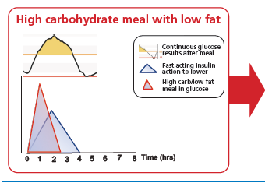
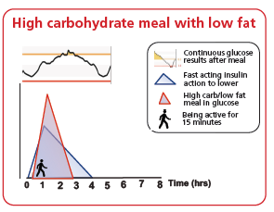
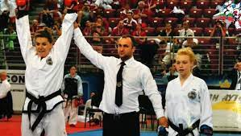
Skin in the Game: Birmingham Art Teaching Activity after meals
Dessi Zaharieva PhD (Stanford)
Friday 1600-17:00 – Technology, Nutrition, Exercise Oral session
O-53 Increasing step count during the first year after diagnosis relates to increased time in range among youth with type 1 diabetes: 4T exercise study results
“Those who teach should do” Nassim Nicolas Taleb

Slide 8
ISPAD 2022 Recommendation
Moderate intensity aerobic activity, such as walking and cycling for 15–45 min between meals, safely lower glucose levels >10 mmol/L (190 mg/dl). B
Adolfsson et al., Pediatr Diabetes. 2022; 23(8):1341-1372.

Slide 9
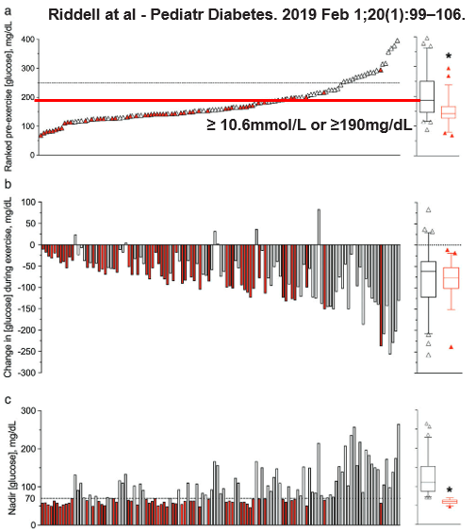
The higher they start, the harder they fall Can that can be used to T1D advantage?
When above 10.6mmol/L (190mg/dL) moderate intensity exercise (brisk walking and cycling) lowers the glucose level with low risk of hypoglycaemia
45 minutes drops by:
Median (quartiles)
110 mg/dL (78 – 160 mg/dL)
6.6 mmol/L (4.3 – 8.9 mmol/L)
<10% hypoglycaemia
44% hypoglycaemia
Riddell et al., Paediat Diabetes 2019; 20(1): 99-106
Notes:
Objective: To evaluate the pattern of change in blood glucose concentrations and hypoglycemia
risk in response to prolonged aerobic exercise in adolescents with type 1 diabetes (T1D) that
had a wide range in pre-exercise blood glucose concentrations.
Methods: Individual blood glucose responses to prolonged (~60 minutes) moderate-intensity
exercise were profiled in 120 youth with T1D.
Results: The mean pre-exercise blood glucose concentration was 178 66 mg/dL, ranging
from 69 to 396 mg/dL, while the mean change in glucose during exercise was −76 55 mg/dL
(mean SD), ranging from +83 to −257 mg/dL. Only 4 of 120 youth (3%) had stable glucose
levels during exercise (ie, ≤10 mg/dL), while 4 (3%) had a rise in glucose >10 mg/dL, and the
remaining (93%) had a clinically significant drop (ie, >10 mg/dL). A total of 53 youth (44%) developed
hypoglycemia (≤70 mg/dL) during exercise. The change in glucose was negatively correlated
with the pre-exercise glucose concentration (R2 = 0.44, P < 0.001), and tended to be
greater in those on multiple daily insulin injections (MDI) vs continuous subcutaneous insulin
infusion (CSII) (−98 15 vs −65 7 mg/dL, P = 0.05). No other collected variables appeared
to predict the change in glucose including age, weight, height, body mass index, disease duration,
daily insulin dose, HbA1c, or sex.
Conclusion: Youth with T1D have variable glycemic responses to prolonged aerobic exercise,
but this variability is partially explained by their pre-exercise blood glucose levels. When no
implementation strategies are in place to limit the drop in glycemia, the incidence of exerciseassociated
hypoglycemia is ~44% and having a high pre-exercise blood glucose concentration is
only marginally protective.

Slide 10
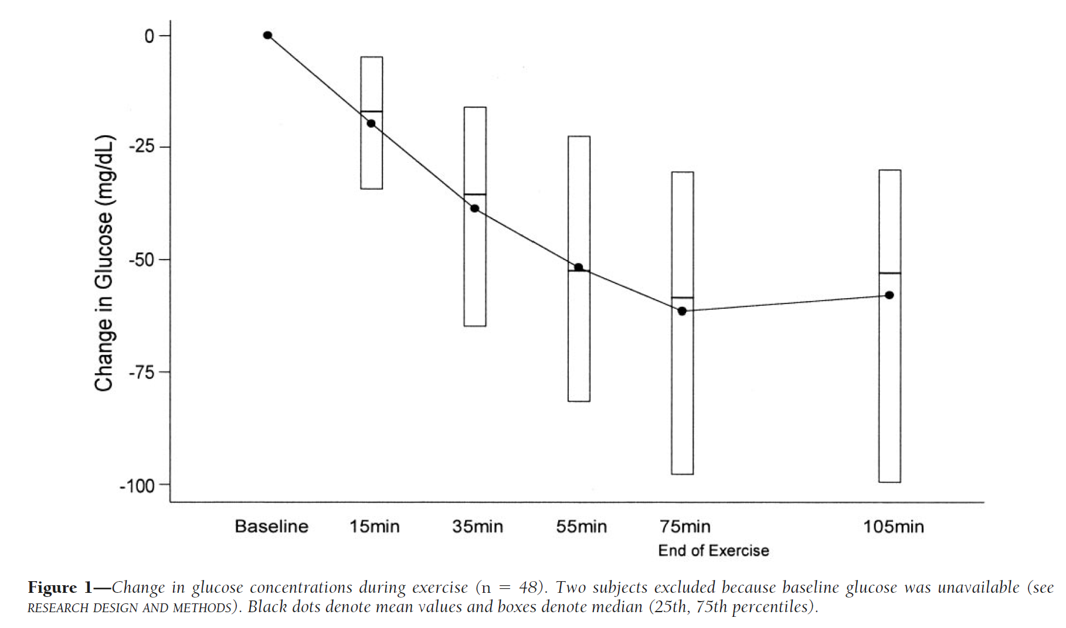
Incremental drop every 15 minutes of fast walking post-meal
Tansey et al., Diabetes Care 29:20–25, 2006

Slide 11
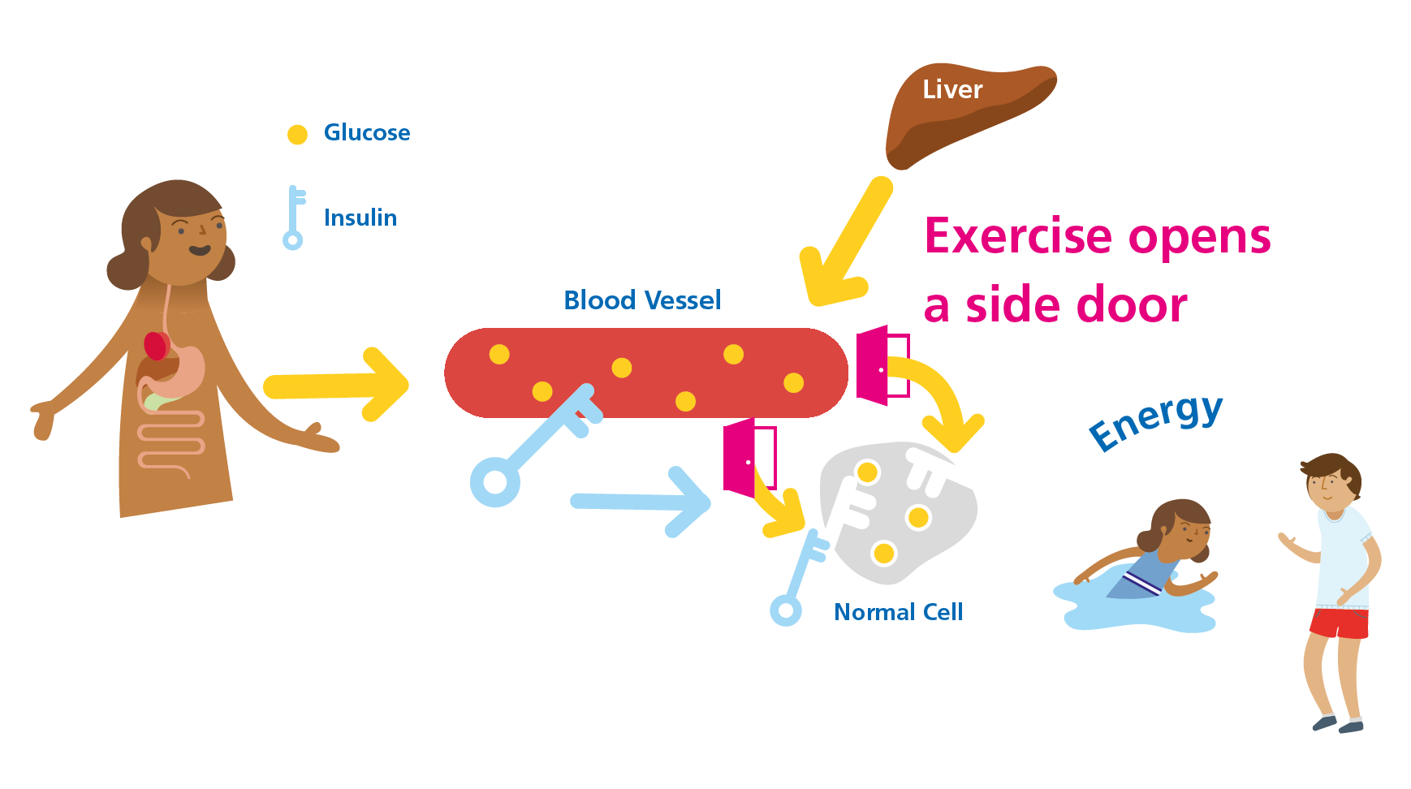
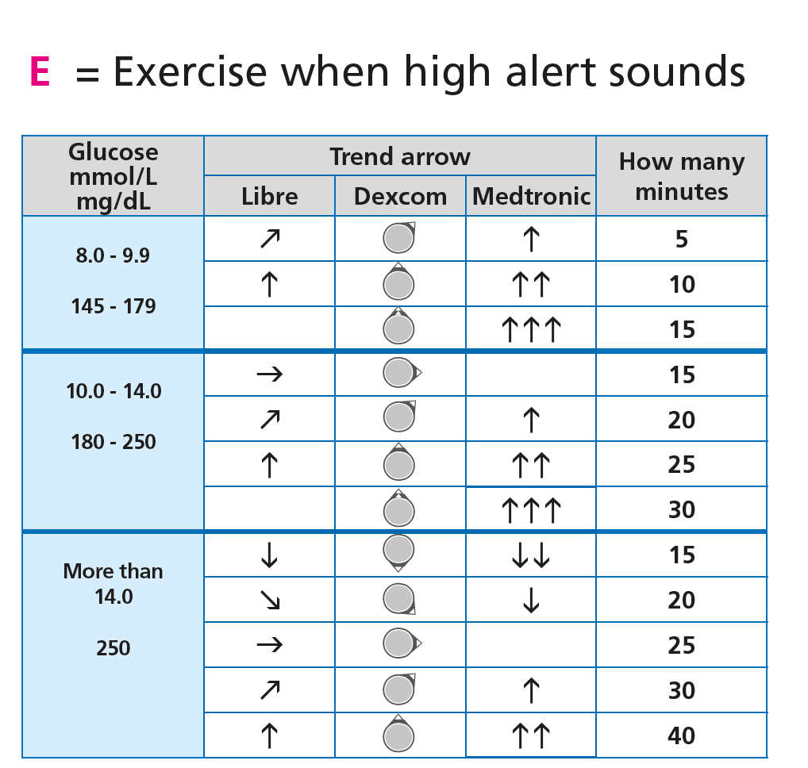
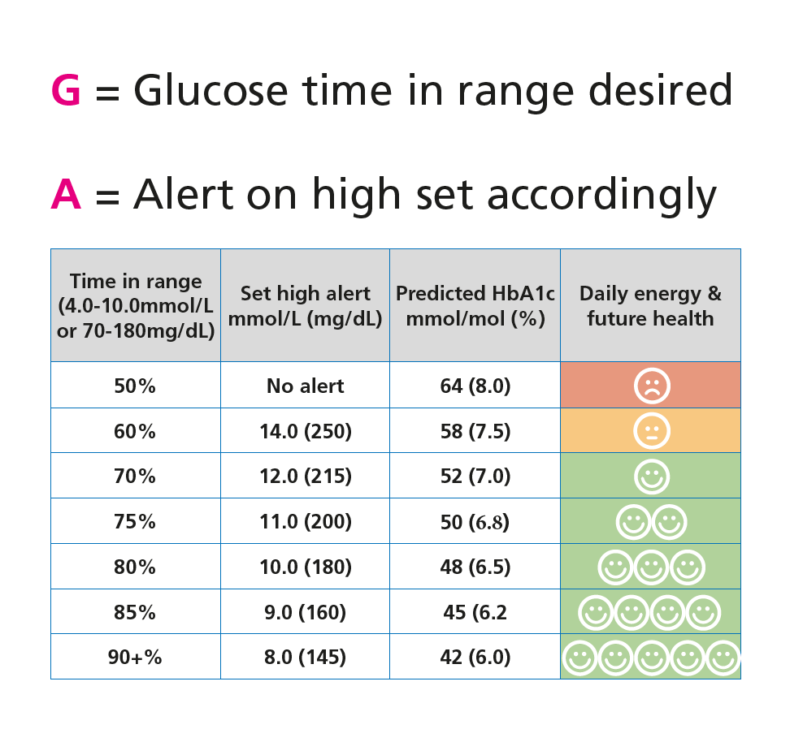
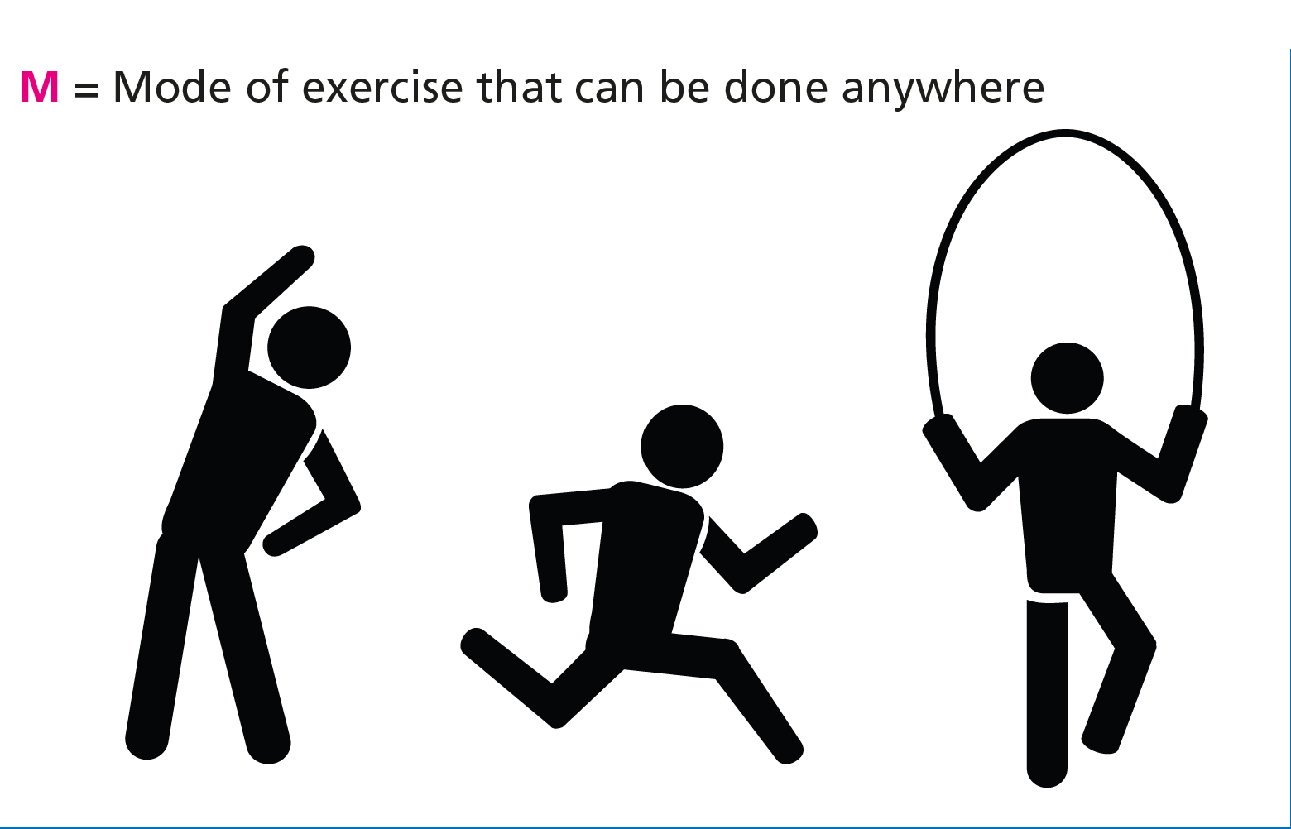
Skin in the Game: Birmingham Art 10 minutes by ~2.0 mmol/L (40 mg/dL)
Pemberton et al., Pediatr Diabetes. 2022;23(7):1045-1056.

Slide 12
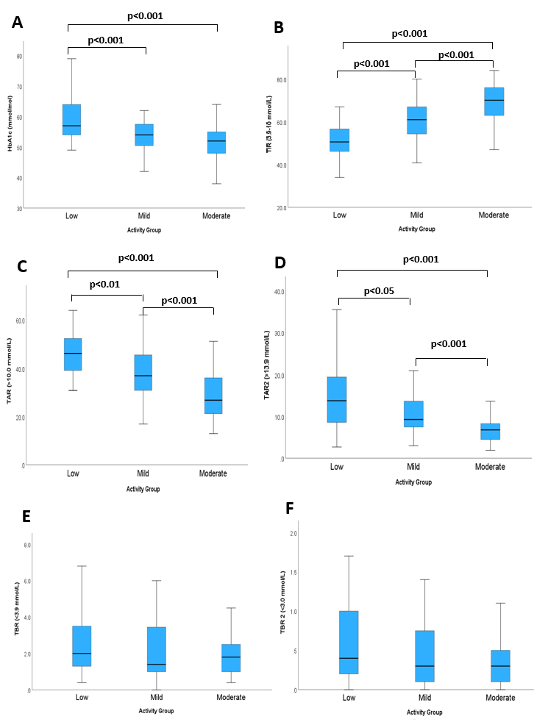
125 paediatrics taught GAME: Results at 6-months
TIR (3.9-10.0 mmol/L)
HbA1c (mmol/L)
When 14.0 mmol/L between meals, how many minutes of moderate intensity activity to lower glucose, usually?
Low (30%) = 0 mins
Mild (34%) = 5-10 mins
Moderate (36%) = >10 mins
No difference in HbA1c at baseline
TAR (>10.0 mmol/L)
TAR2 (>13.9 mmol/L)
TBR (<3.9 mmol/L)
TBR2 (<3.0mmol/L)
Limitations:
Self-report
Intensity not verified
Association not causation
Socioeconomically biased (moderate group)
Pemberton et al., Pediatr Diabetes. 2023 Article ID 2519368
https://doi.org/10.1155/2023/2519368

Slide 13
Movement = Time in Range
Exercise = Hypoglycaemia

Slide 14
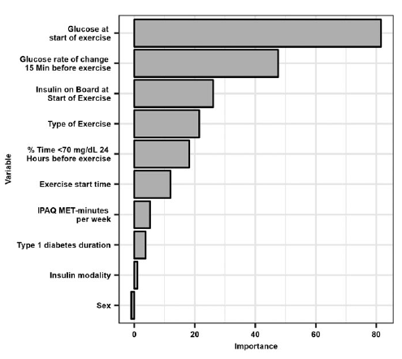
T1DEXI: Exercise hypoglycaemia risk factors
Bergford et al., Diabetes Technol Ther, 2023; 25(9), DOI: 10.1089/dia.2023.0140

Slide 15
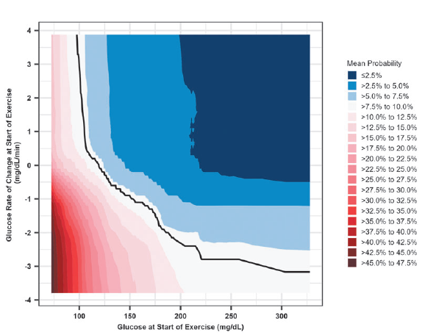
T1DEXI: 1. Pre-exercise glucose level 2. Rate of change
Bergford et al., Diabetes Technol Ther, 2023; 25(9), DOI: 10.1089/dia.2023.0140

Slide 16
Self Monitoring Blood Glucose: Carbohydrates during exercise
Adolfsson et al., Pediatr Diabetes. 2022; 23(8):1341-1372.

Slide 17
Skin in the Game: Birmingham Art BG: Carbohydrates during exercise

Slide 18
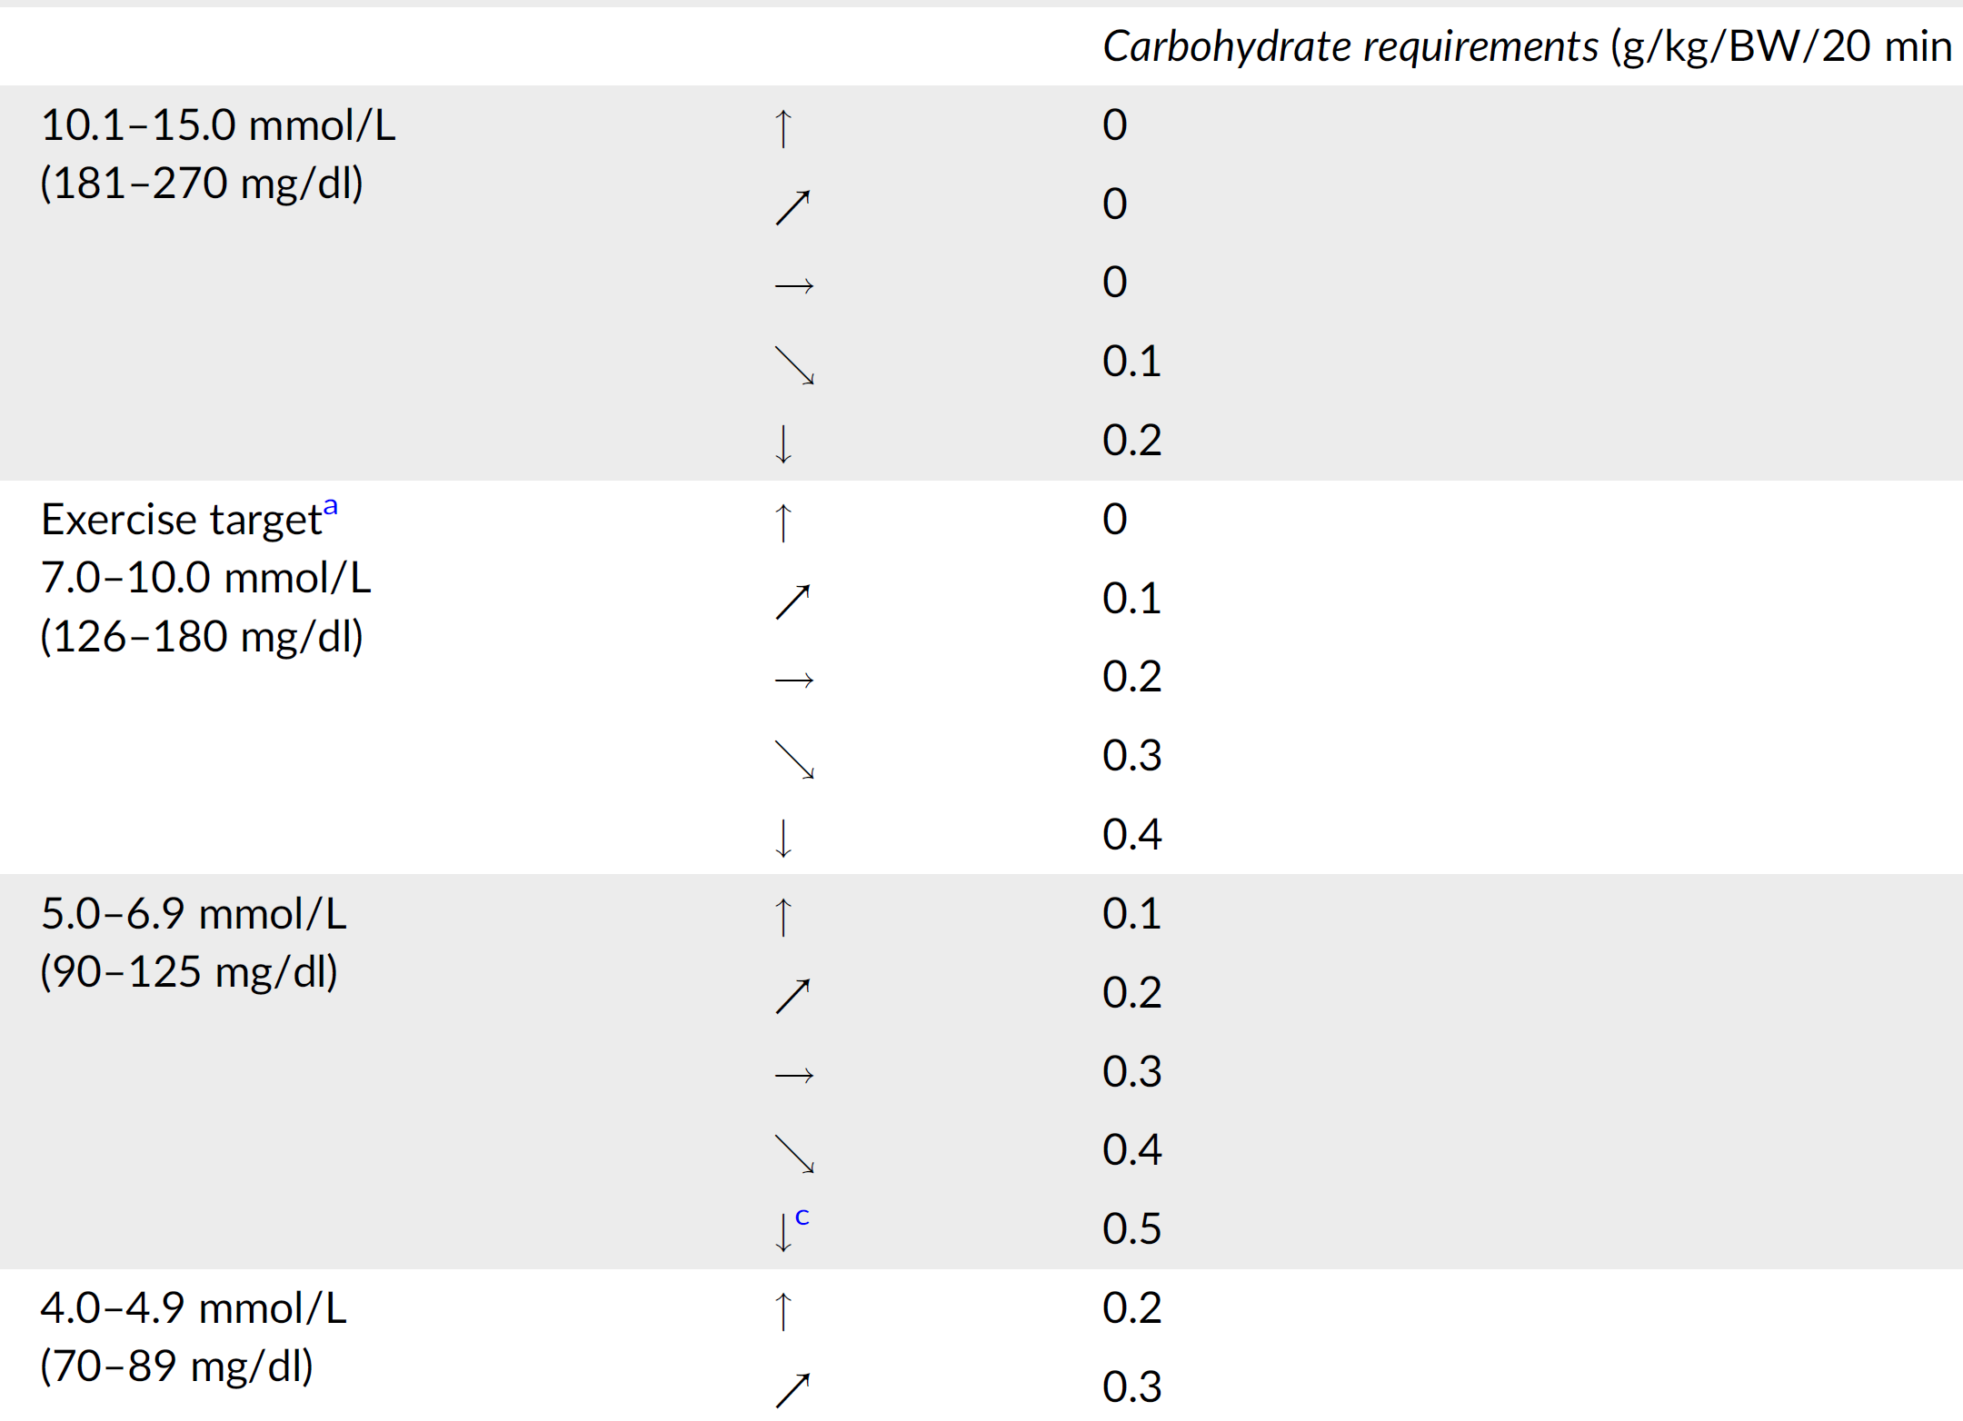
CGM: Carbohydrates during exercise
T1DEXI at home exercise study:
Pre-exercise glucose level and rate of change are the two strongest predictors of hypoglycaemia
DOI: 10.1089/dia.2023.0140
Adolfsson et al., Pediatr Diabetes. 2022; 23(8):1341-1372.

Slide 19
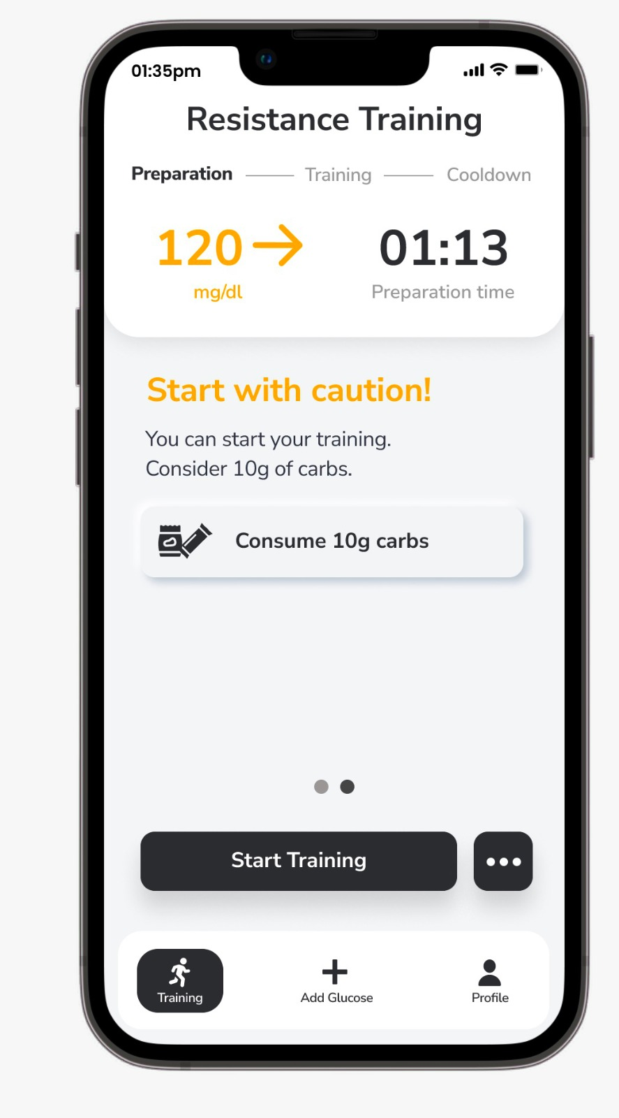
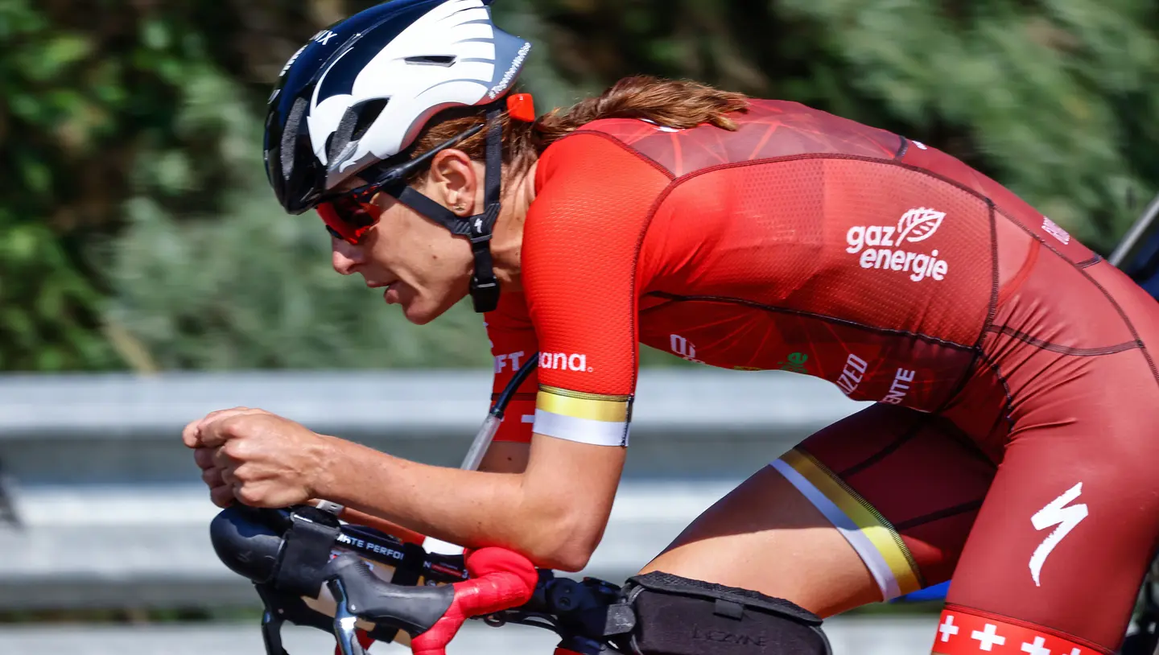
Skin in the Game: Birmingham Art CGM: Carbohydrates during exercise
Prof Othmar Moser
GLAICE©
“Those who teach should do” Nassim Nicolas Taleb

Slide 20
Carbohydrate: Just before and during exercise
Fluid options:
Glucose based (most effective) options:
Isotonic sports drinks 6%–8%
(6–8 g/100 ml)
Glucose energy drinks 8%–10%
(8–10 g/100 ml)
Glucose shots 25%
(25 g/100 ml)
Glucose sports gels 60%–70%
(60–70 g/100 ml)
Sucrose (glucose/fructose) options:
Fruit juice 11% (11 g/100 ml)
Sweetened drinks 8%–10% (8–10 g/100 ml)
Solid options
Glucose based (most effective) options:
Dextrose tablets (3 g each)
Glucose tablets (4 g each)
Sucrose (glucose/fructose) options:
Candy/sweets 75%–90% (75–90 g/100 g)
If unable to monitor glucose level frequently or at all during exercise:
Before or during exercise include:
Banana (22 g/100 g)
Breakfast bar (67 g/100 g)
Muesli bar (53 g/100 g)
Rice cakes (83 g/100 g)
Up and Go (10 g/100 ml)
Low fat natural yoghurt
(7 g/100 g)
Adolfsson et al., Pediatr Diabetes. 2022; 23(8):1341-1372.

Slide 21
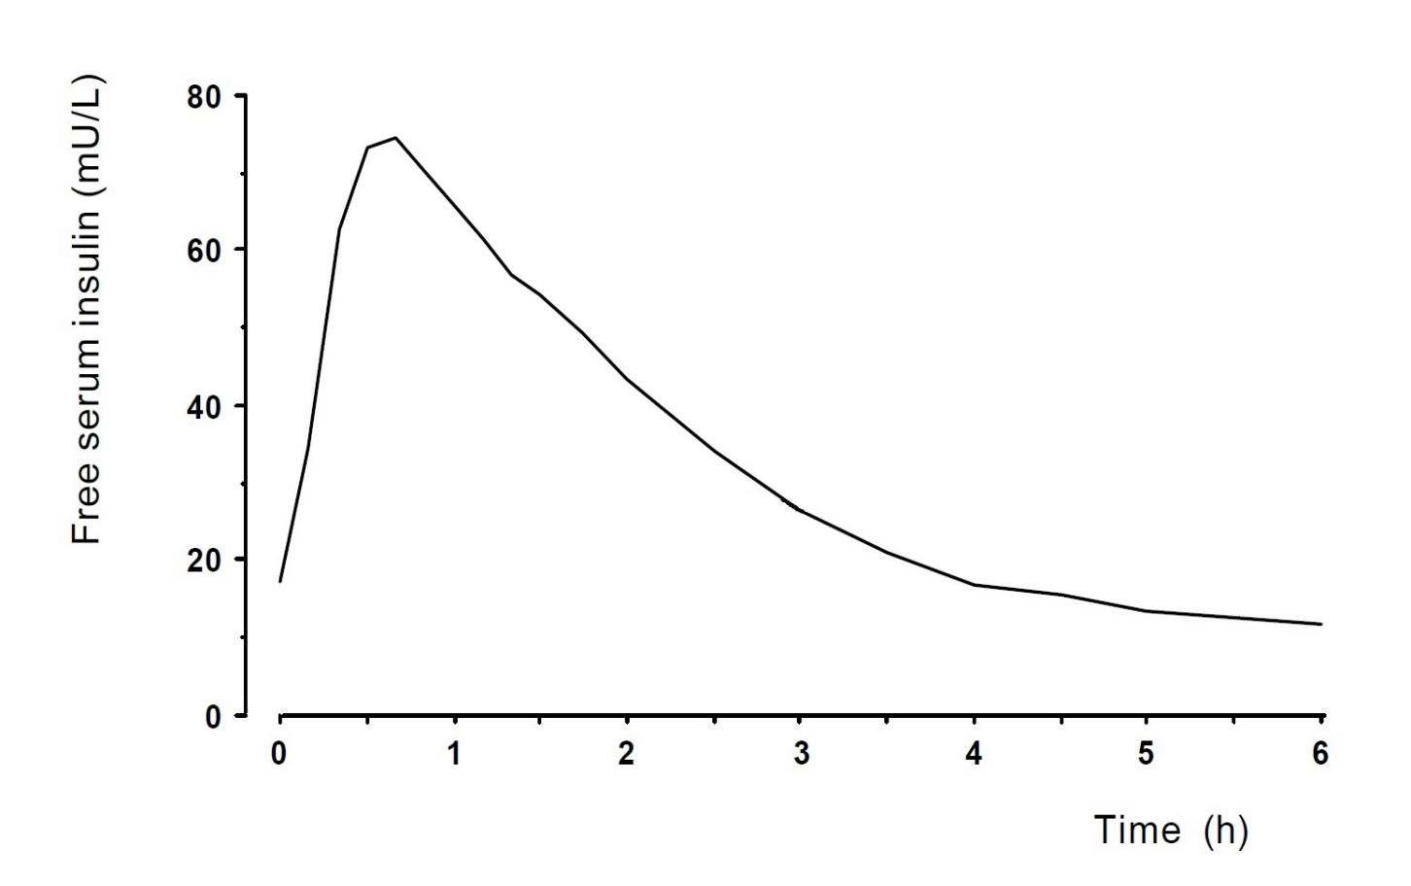
T1DEXI: 3. Insulin on board
Within 2 hours
Bolus reductions are required
Three-hour rule (aspirational)
>80%hypoglycaemia
Bergford et al., Diabetes Technol Ther, 2023; 25(9),
DOI: 10.1089/dia.2023.0140
Riddell et al., Paediat Diabetes 2019; 20(1): 99-106

Slide 22
Aspirational 3 hour rule
Meal and insulin 3 hours before exercise
Breakfast examples:
Fruit salad/milk/nuts/yoghurt
Toast/eggs/tomato/fruit
Breakfast cereal/milk
Rolled oats/milk/nuts/fruit
Toast/Avocado/eggs
Pancakes/bacon/mushrooms/tomato
Omelette/cheese/salad/bread roll
Crepes/chicken/pea salad
Lunch examples:
Sandwich or bread roll/lean meat or cheese/salad
Wholegrain toast/peanut butter/banana
Wrap/chicken/salad/baked beans
Wheat biscuits/low fat cottage cheese/fruit
Dinner examples:
Pasta/tomato-based sauce/mincemeat/ vegetables
Rice/fish/vegetables/tomato-based sauce
Pad Thai/meat or fish/salad
Jacket potato/tuna/mayonnaise/salad
Lasagne/garlic break/vegetables
T1DEXI at home exercise study
Insulin on board was the 3rd strongest predictor of glucose decrease during all types of exercise.
DOI: 10.1089/dia.2023.0140
Adolfsson et al., Pediatr Diabetes. 2022; 23(8):1341-1372.

Slide 23
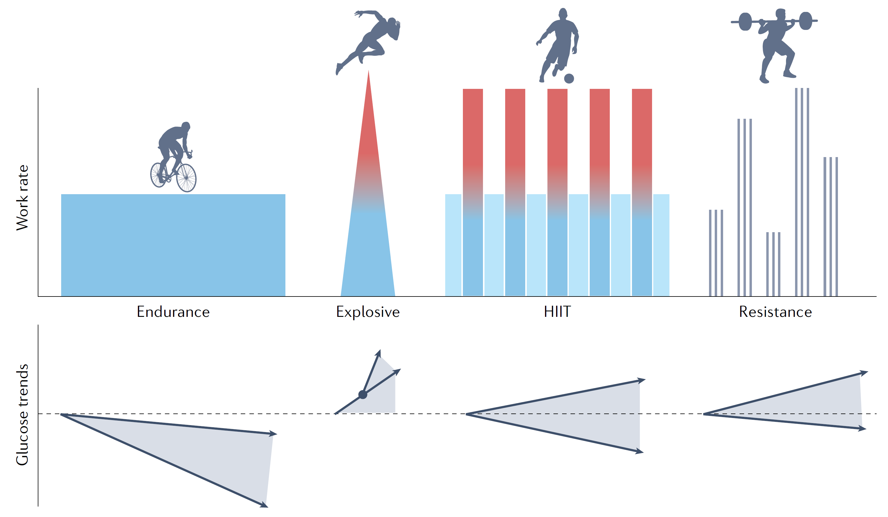
T1DEXI: 4. Type of Exercise
Exercise when meal insulin was delivered within 3 hrs
(Not on the original graphic, added by J Pemberton October 2023)
Riddell & Peters, Nat Rev Endocrinol. 2023 Feb;19(2):98-111

Slide 24
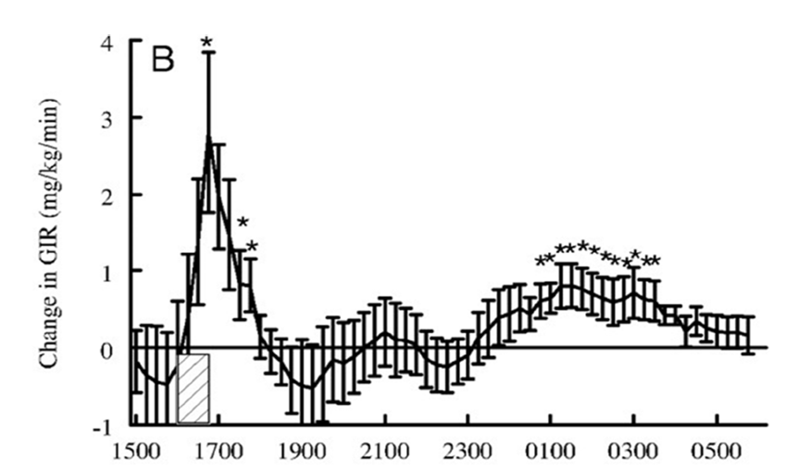
Insulin sensitivity after exercise
McMahon et al., The Journal of Clinical Endocrinology & Metabolism, 2007; 92 (3), 963–968

Slide 25
Before bed if exercise after 4pm
Exercise post-16:00 and duration≥30 min
Glucose level <10 mmol/L (180 mg/dl): Carb
Glucose level <7 mmol/L( 126 mg/dl): Carb + protein
Carb: 0.4 g/kg/BW low-medium GI + protein: 15 g
Low-medium GI carb options:
200 g milk (10 g)
1 slice multigrain bread or toast (15 g)
50 g cooked chickpeas (15 g)
1 large apple or medium banana (15 g)
200 g plain yoghurt (14 g)
Protein options:
50 g mixed chopped nuts (8 g) / 2 eggs (14 g) / 70 g canned fish (15 g) / 150 g low fat cheese (15 g) /
200 ml milk (7 g) / 200 g plain yoghurt (7 g)
Adolfsson et al., Pediatr Diabetes. 2022; 23(8):1341-1372.

Slide 26
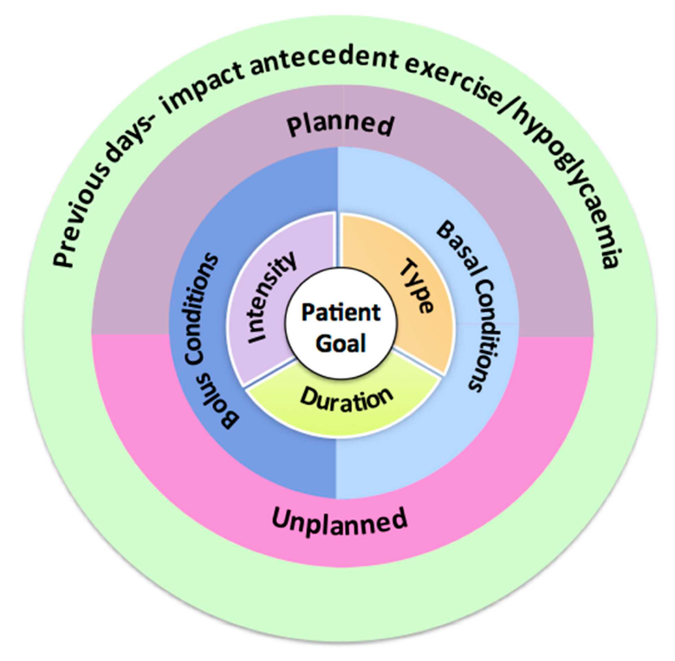
Structuring a consultation
Chetty et al., Front Endocrinol (Lausanne). 2019;10:326.

Slide 27
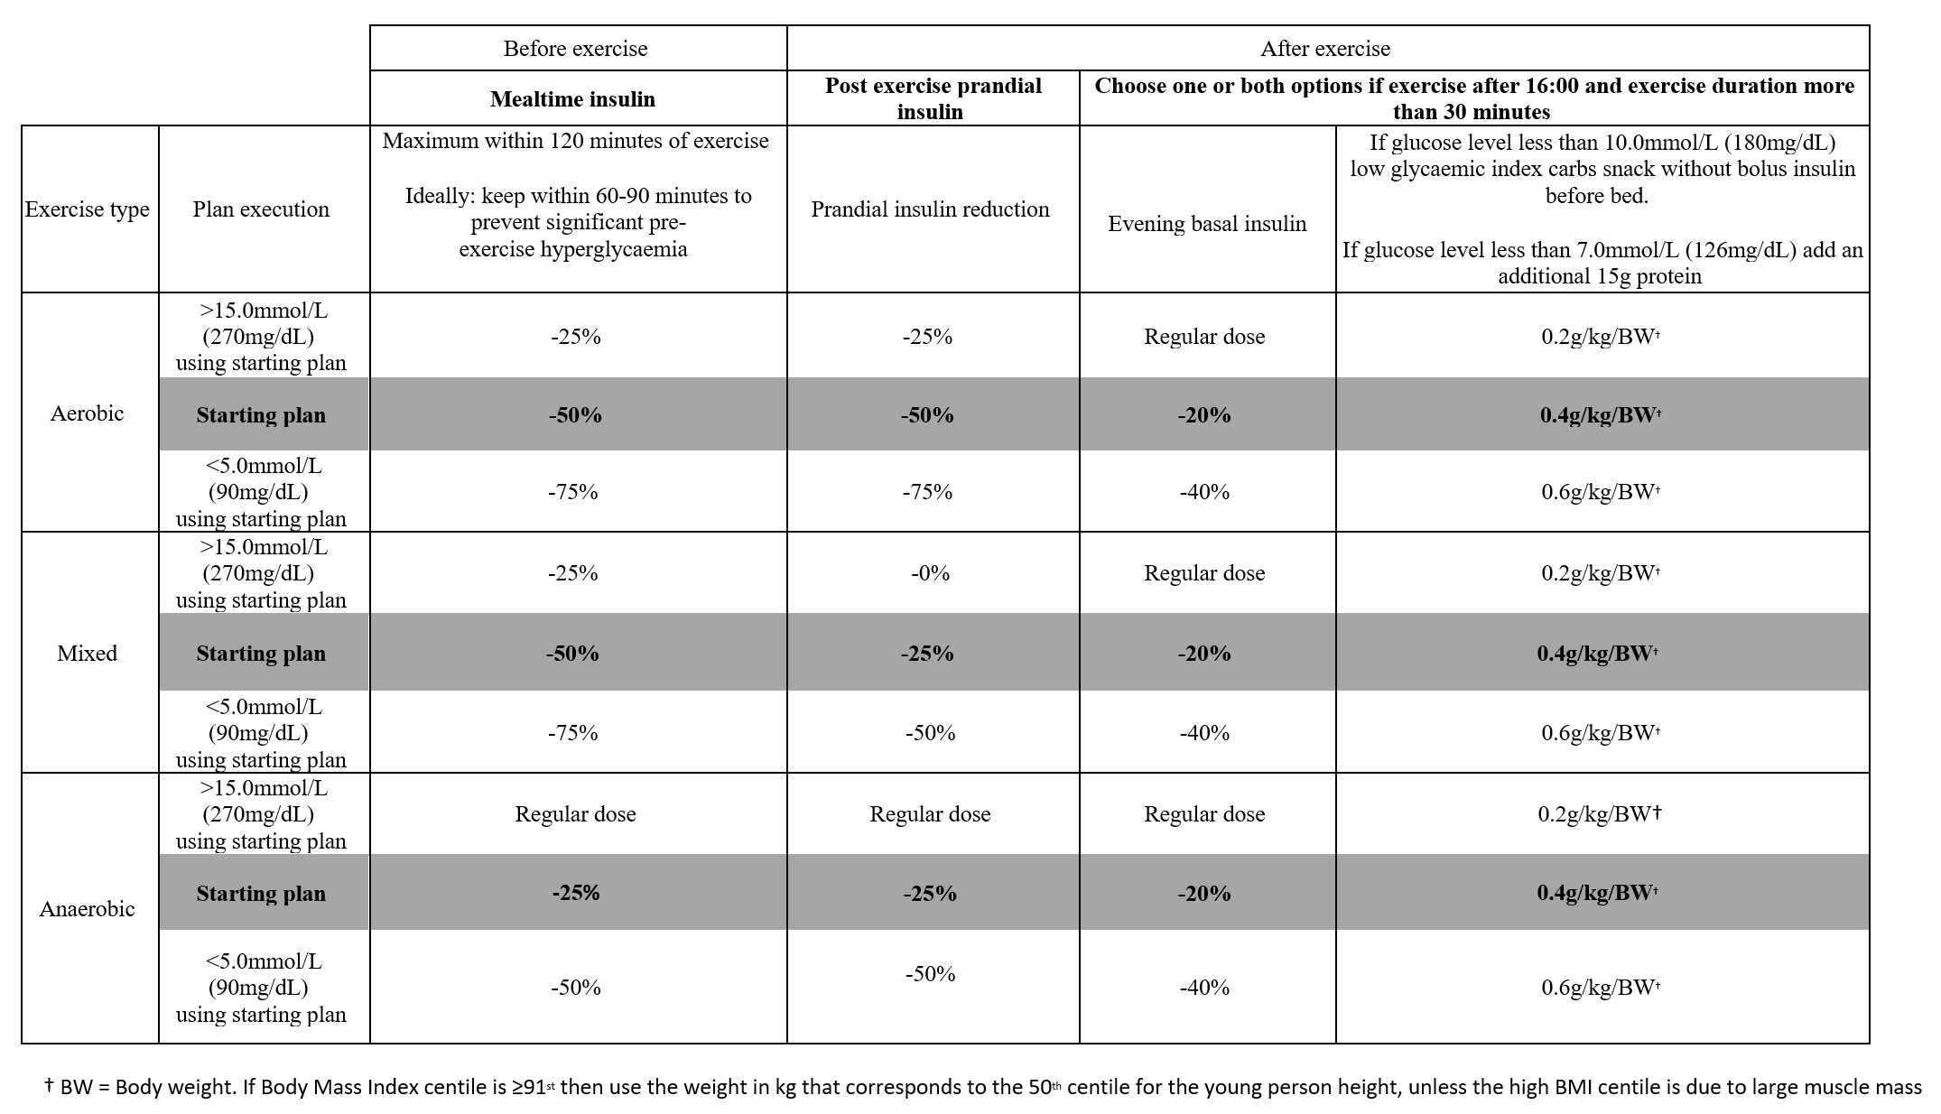
MDI – ISPAD 2022
Adolfsson et al., Pediatr Diabetes. 23(8):1341-1372.

Slide 28
Skin in the Game: Birmingham Art 50/50/20
Gregg is running at 12:00 for 1 hour, 1u:10g Carb ratio
Breakfast 10:00: 60g = 6units = -50% = 3 units
Lunch 14:00: 100g = 10 units = -50% = 5 units
Convex tinkering: Above 15.0mmol/L during exercise with 50% bolus reduction pre-exercise
Next time only 25% reduction

Slide 29
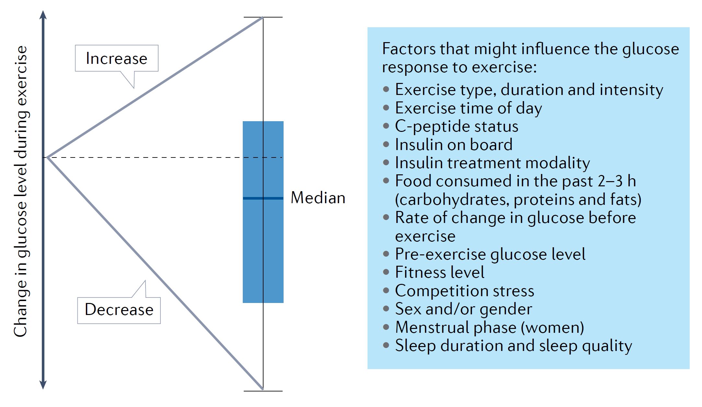
The Glucose Never Lies
Riddell & Peters, Nat Rev Endocrinol. 2023 Feb;19(2):98-111

Slide 30
AID Systems Activity setting 90-120 mins before (if not possible, just before will do)
Variable | 670G | 780G | T-Slim Control IQ | CAMAPS FX | Omnipod 5
Usual Target Activity targets | 6.7mmol/l Temp Target: 8.3mmol/l | 5.5mmol/l Default 6.1mmol/l 6.7mmol/l Temp Target: 8.3mmol/l & no auto correction | 6.3-8.9mmol/L Exercise Target: 7.8-8.9mmol/l Sleep: 6.1-6.3mmol/l | Set at 5.8mmol/L 4.4 – 11.0mmol/L Ease Off: Increases set target by 2.5mmol/l | User defined 6.1-8.3mmol/L Activity mode: Increases set target to 8.3mmol/L
Adolfsson et al., Pediatr Diabetes. 2022; 23(8):1341-1372.

Slide 31
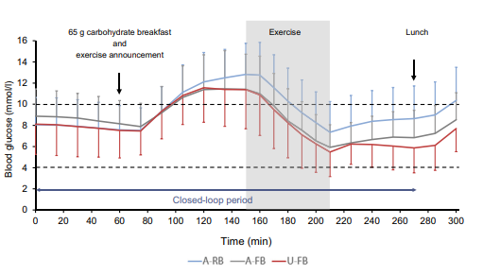
Exercise 90 minutes after breakfast 39 adults under three conditions
A-RB = Activity mode and reduced bolus (33%)
A-FB = Activity mode and Full bolus
U-FB = Usual target and Full bolus
Model Predictive Control Algorithm
Tagougui et al., Diabetologia 2020; 63:2282-2291
Notes:
Activity mode and reduced bolus (33%):
2% <3.9mmol/L from exercise to 1 hr after
Activity mode and Full bolus:
7% <3.9mmol/L from exercise to 1 hr after (p<0.01)
Usual target and Full bolus:
13% <3.9mmol/L from exercise to 1 hr after (p<0.0001)

Slide 32
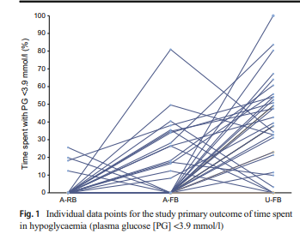
Exercise 90 minutes after breakfast 39 adults under three conditions
A-RB = Activity mode and reduced bolus (33%)
A-FB = Activity mode and Full bolus
U-FB = Usual target and Full bolus
Tagougui et al., Diabetologia 2020; 63:2282-2291

Slide 33
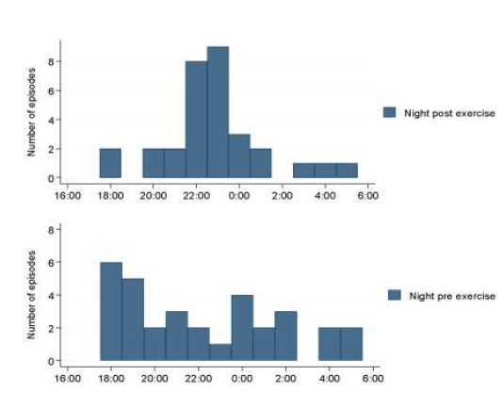
How does MiniMed 670G cope after three different types of exercise?
33 adults with T1D
Last meal and food insulin 13:00
(45g CHO, 25g PRO, 10g FAT)
Exercise target stated 14:00
Exercise at 16:00 for 40 mins
HITT (4x4 of 80% max ergometer)
Resistance (4 sets whole body)
Moderate (25% max ergometer)
Exercise target off immediately after
No food for 4 hours
Usual insulin with meal 20:40
60g (45g) CHO, 25g PRO, 20g FAT)
Overnight 00:00-06:00
Morrison et al., Diabetes Technol Ther. 2022;24(12):873-880
Notes:
33 adults with type 1 diabetes
Three conditions
Control
40 minutes high intensity exercise (16:00)
40 minutes aerobic exercise (16:00)
Activity mode stopped after exercise
No difference in hypoglycaemia overnight
Conclusion
Activity mode can be stopped after exercise

Slide 34
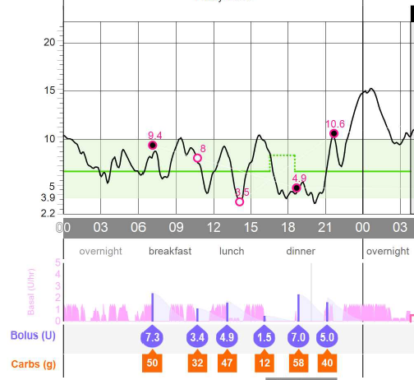
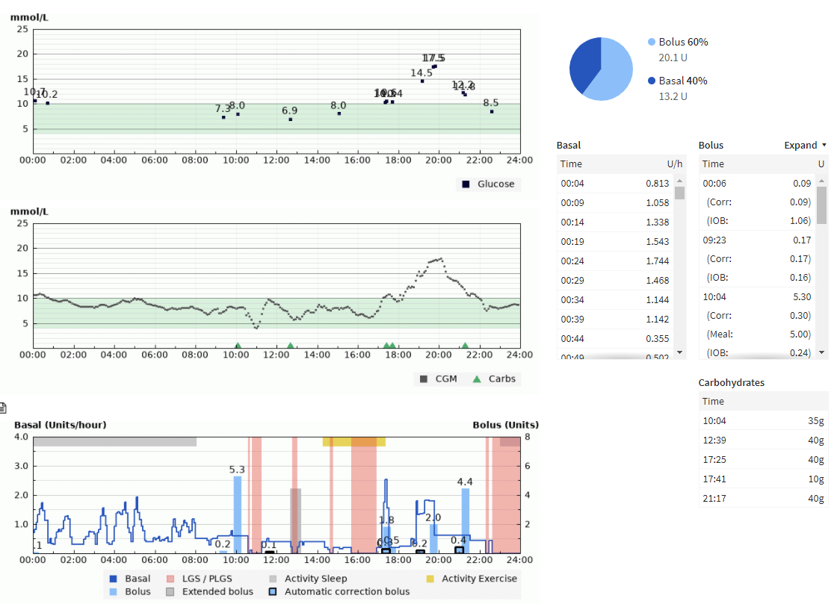
Post-exercise hyperglycaemia – Beware of prolonged insulin suspension

Slide 35
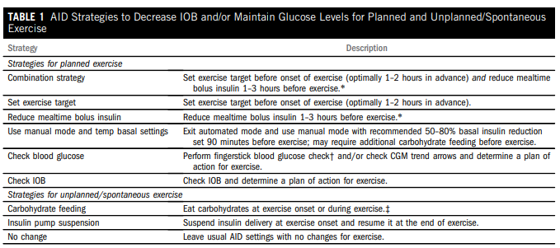
Practical aspects of AID
Zaharieva et al. Diabetes Spectr. 2023;36(2):127-136.

Slide 36
Skin in the Game: Birmingham Art 25/25/Target
 |  | Before exercise |  | During Exercise | After exercise
 |  | Prandial insulin | Activity target | Carbohydrate | Activity target | Post exercise prandial insulin
 | Plan execution | If meal is consumed within 2 hours of exercise, adjust prandial dose using these suggestions | Ideally start Activity target 90-120 minutes before exercise BUT start just before if 90-120 mins is not possible | Consume quickly absorbed carbohydrate based on sensor value and trend arrow every 20-30 minutes
Exercise | >15.0mmol/L using starting plan | Regular prandial insulin dose | Off | Follow carbohydrate chart | Off | Regular prandial insulin dose
 | Starting plan | -25% | On |  | Off | -25%
 | <5.0mmol/L using starting plan | -50% | On |  | On for 6 hours | -50%

Slide 37
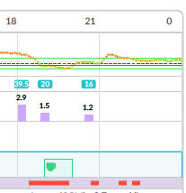
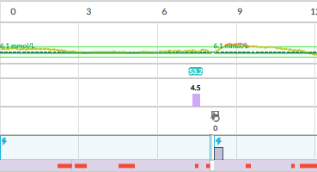
25/25/Target
Football: 19:00 to 20:00
-25% carbs enter 18:00 and 18:30
Activity Mode on 19:00 for 1 hour (forgot 90 mins before) – See basal suspension for full hour
10g glucose 19:00 and another 10g and 19:30
-25% carbs enter 21:00 and activity mode off

Slide 38
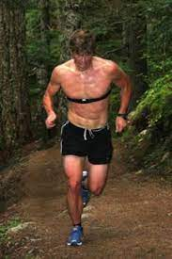
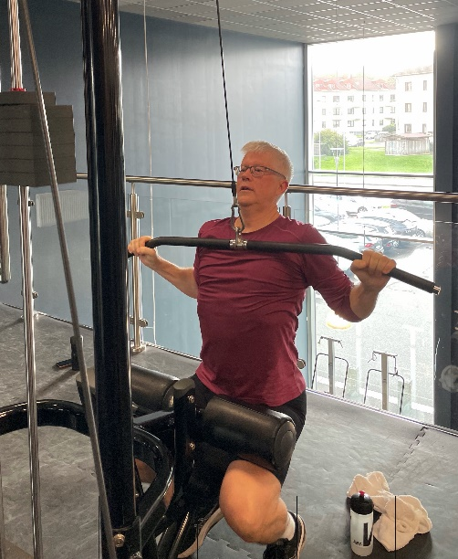
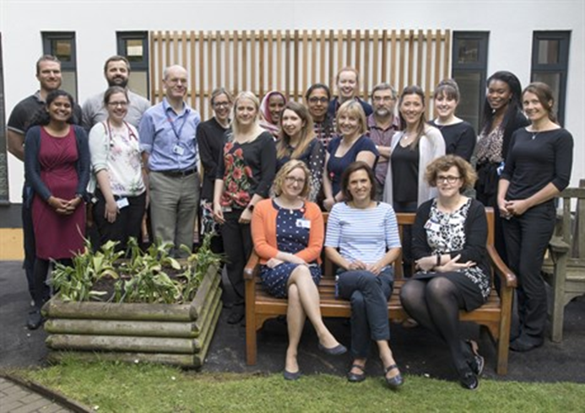
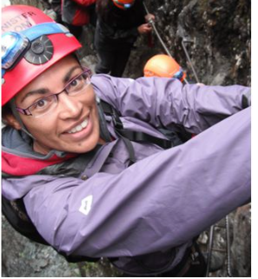
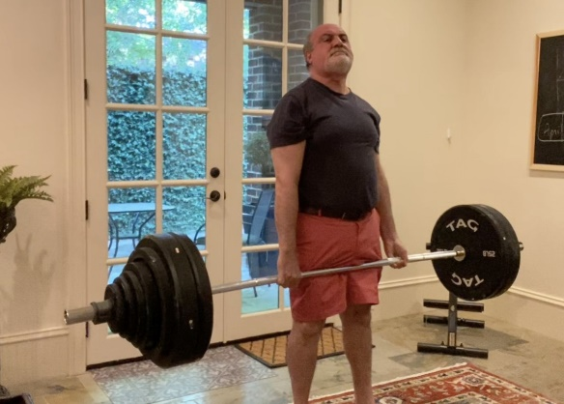
Acknowledgements “Those who teach should do” Nassim Nicolas Taleb
Birmingham Women’s and Children’s Diabetes Team
Dr Suma Uday (Mentor)
Prof Mike Riddell
Dr Peter Adolfsson
Francesca Annan RD
Dr Dessi Zaharieva
Prof Othmar Moser
Nassim Nicolas Taleb

Slide 39
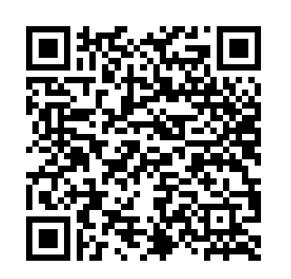
Summary
Skin in the Game Heuristics: Birmingham’s Art
10 by 2.0 mmol/L (40 mg/dL)
50/50/20 for MDI and CSII
25/25/Target for AID
The Glucose Never Lies
Things to read:
ISPAD 2022: Exercise Guidelines
Nassim Nicolas Taleb
Skin in the Game
Become an Artist:
Birmingham Resources – I grant ubiquitous permission
Adobe Acrobat Pro
johnpemberton@nhs.net

