Slide 1


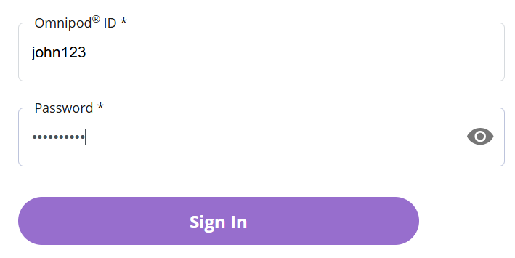
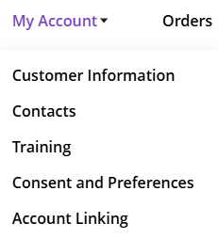


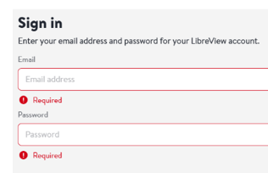



www.theglucoseneverlies.com
Freestyle LibreLinkUp and the Omnipod ® 5 System
Setting up Followers
You’ll need:
Your Omnipod ID and password (UK site).
A LibreView username and password (or be ready to create one).
The follower’s name and email address (the people who will view your glucose).
Step 1: Login into Omnipod UK with your Omnipod ID and Password https://www.omnipod.com/en-gb
Step 2: Open My Account and Select Account Linking
1
1
2
3
2
Step 3: Link to LibreView
Step 4: Sign into LibreView
1
2
3
1
Step 5: Confirmation that Data Sharing is enabled
1

Slide 2

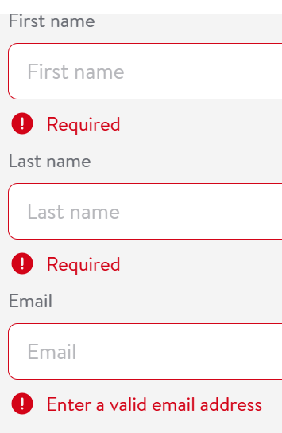





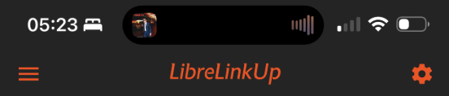

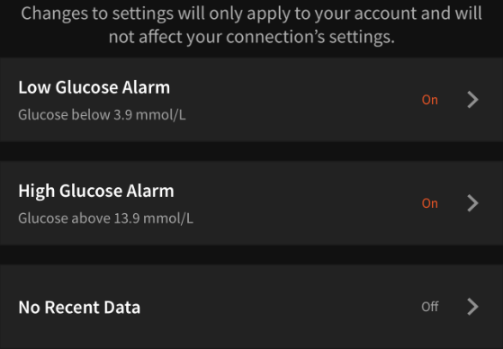
www.theglucoseneverlies.com
Step 6: Confirm Linking and select “Manage Libre LinkUP”
Step 7: Login to LibreView and Add Followers
1
1
2
2
3
4
3
Step 8: Followers receives email and sets up LibreLinkUp App (check junk)
Step 9: LibreLink UP settings- & Alarms Low Glucose Alarm, High Glucose Alarm, and No Recent Data
1
1
2
Create an account using the email from Step 7
Agree and accept
You are following
3
2
Step 10: Repeat this process for up to 20 followers

